Slide 1
CAPSTONE PROJECT
Presented By:
Student Name-
College Name-
Department
4. AICTE ID

Slide 2
OUTLINE
Problem Statement (Should not include solution)
Proposed System/Solution
System Development Approach (Technology Used)
Algorithm & Deployment
Result
Conclusion
Future Scope
References

Slide 3
Problem Statement
Problem Statement
Finding a suitable blood donor during emergencies can be difficult and time-consuming.
Donor information is often scattered across different sources.
Manual donor searching makes emergency response slower.
Patients need compatible donors based on blood group, donation type and location.
A centralized system is required to connect donors with recipients efficiently.
Goal: Reduce the time required to identify suitable donors during urgent situations.

Slide 4
Proposed Solution
LifeLink AI
LifeLink AI is a Streamlit-based donor-recipient matching platform designed to simplify emergency blood and organ donation coordination.
Key Components:
👤 Donor Registration
🚨 Urgent Donation Requests
🔗 Automated Donor Matching
🩸 Blood Compatibility Checking
📍 Location-based Prioritization
📊 Real-time Dashboard
🤖 AI-powered Assistant
The system filters compatible and available donors and ranks potential matches based on relevant criteria.

Slide 5
System Approach
Development Approach
1. User Input
Donor registration
Recipient emergency request
2. Data Processing
Validate donor/request information
Check availability
Identify blood and donation type
3. Matching
Blood compatibility
Donation type
Organ compatibility
City/location priority
4. Results
Rank suitable donors
Display match score
Provide match information
5. AI Assistance
Gemini-powered assistant provides contextual guidance and explanations.

Slide 6
TECHNOLOGIES USED
Technology | Purpose
Python | Core application logic
Streamlit | Web application & UI
Google Gemini API | AI Assistant
Pandas | Data handling
Session State | Temporary application data
Git & GitHub | Version control
Streamlit Cloud | Deployment

Slide 7
Algorithm & Deployment
Matching Algorithm
Input:
Donor details
Blood group
Donation type
Organ type
City/location
Availability
Matching Process
Donor / Recipient Request
↓
Check Availability
↓
Check Donation Type
↓
Check Blood Compatibility
↓
Check Organ Compatibility
↓
Calculate Match Score
↓
Rank Suitable Donors
↓
Display Matches

Slide 8
Result
System Results
The developed prototype successfully demonstrates:
✅ Donor registration
✅ Emergency request creation
✅ Compatible donor filtering
✅ Location-based prioritization
✅ Match scoring and ranking
✅ Dashboard for system overview
✅ AI-powered assistance
Expected Outcome
The system helps reduce manual searching and provides a structured way to identify potential donors quickly.

Slide 9
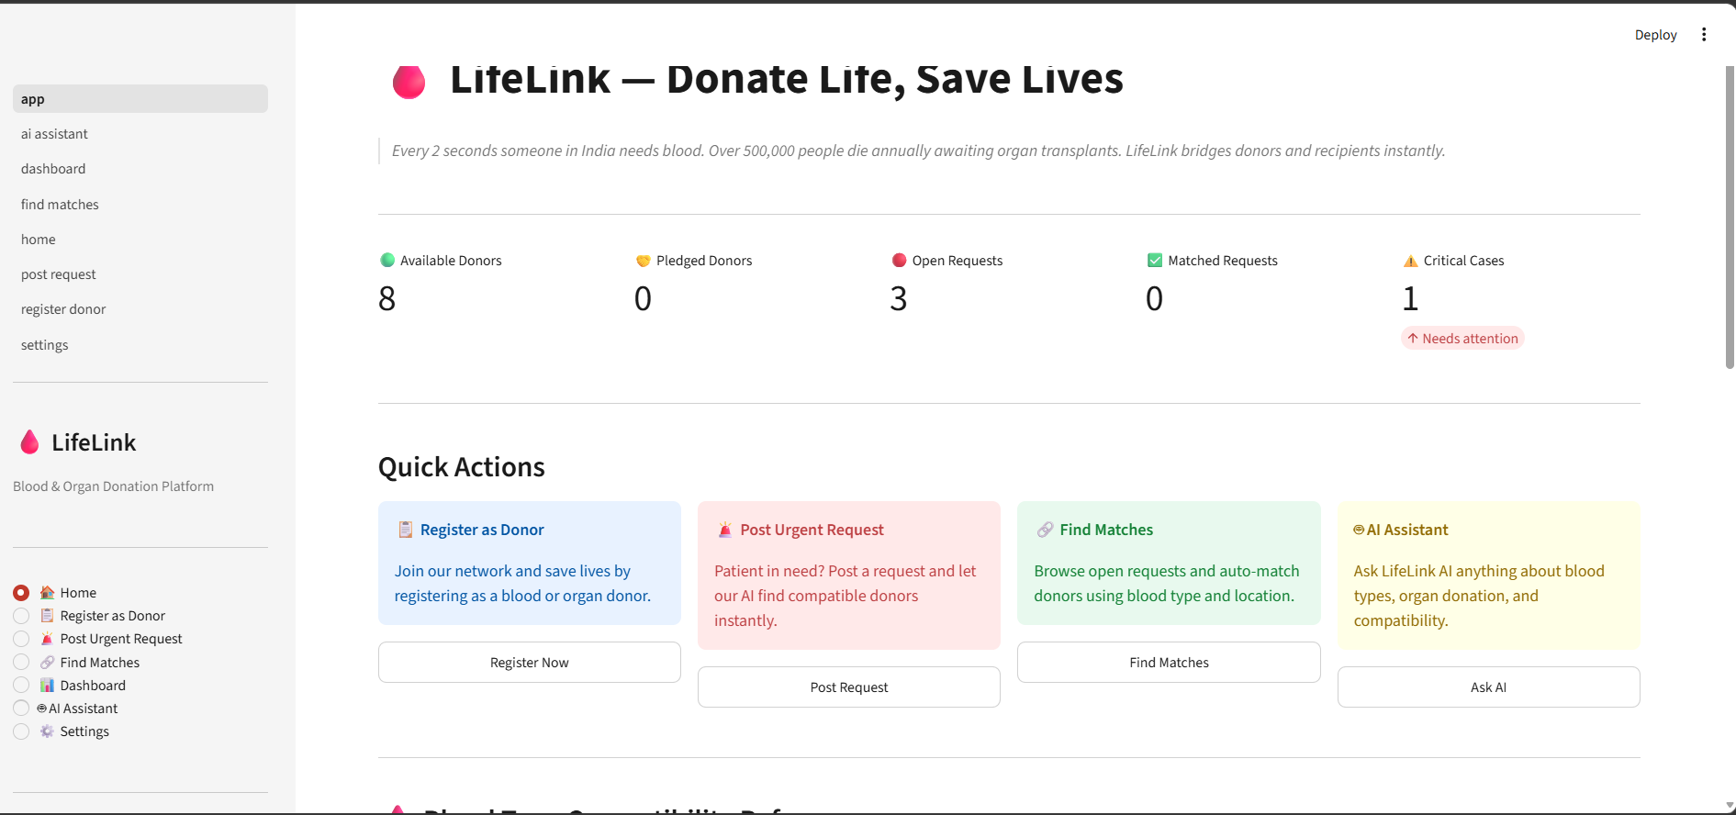
Result

Slide 10
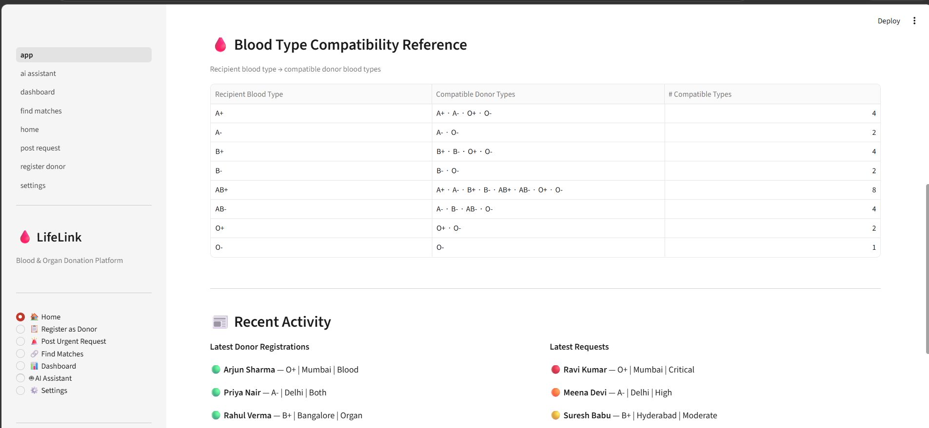
Result

Slide 11
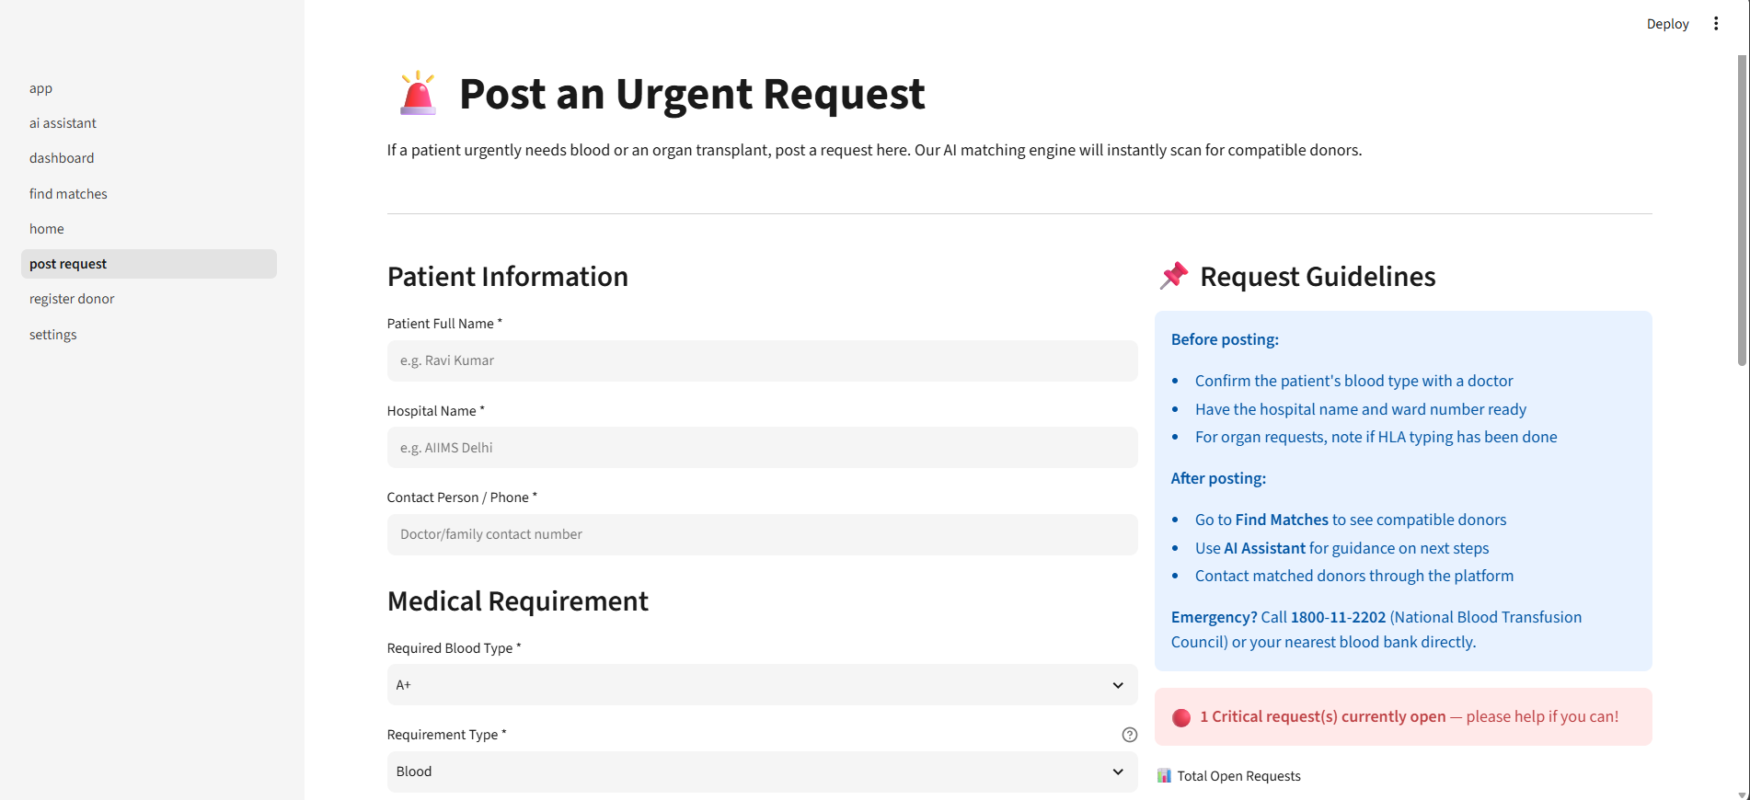
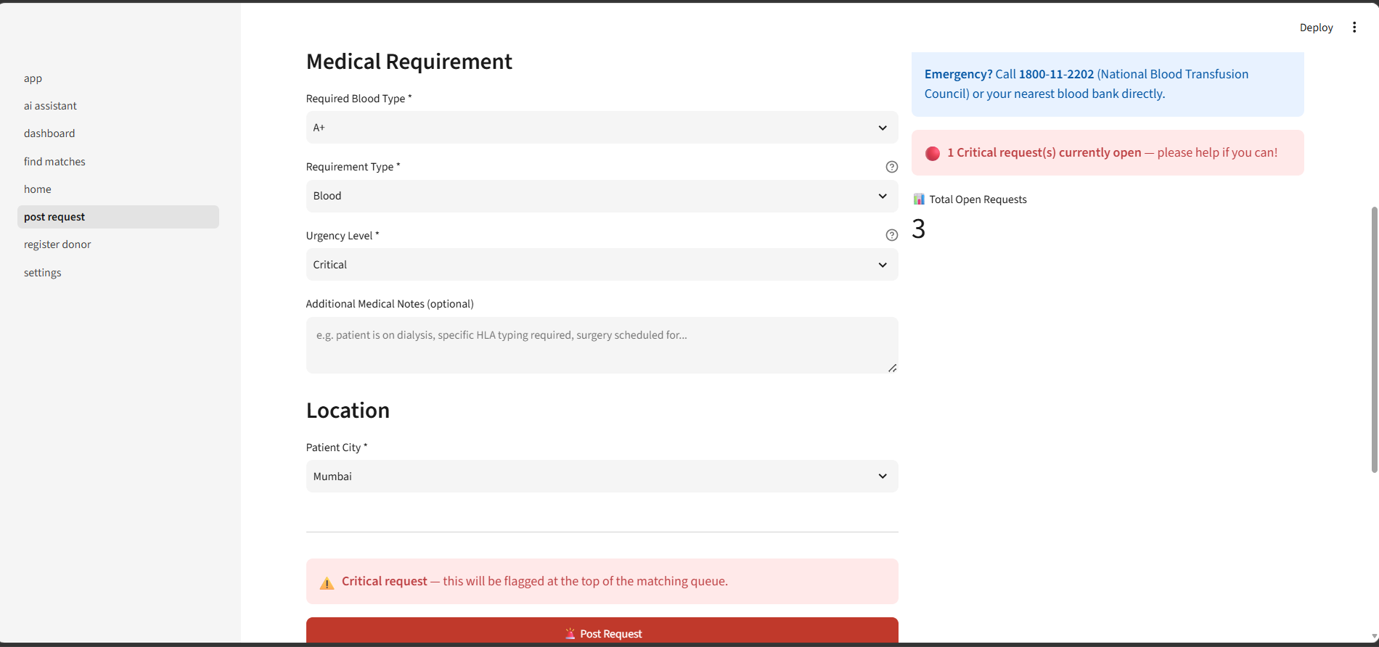
Result

Slide 12
Conclusion
Conclusion
LifeLink AI provides a centralized platform for donor-recipient coordination.
The matching algorithm identifies potential donors using compatibility and availability criteria.
Location-based prioritization helps surface nearby donors.
Gemini AI enhances the application with intelligent assistance.
Streamlit provides a simple and accessible interface.
Overall: LifeLink AI demonstrates how AI and automation can support faster and more organized donor matching.

Slide 13
Future scope
Future Enhancements
📍 Real-time GPS-based distance calculation
🔔 SMS / Email / Push notifications
🗄️ PostgreSQL / MongoDB database integration
👨‍💼 Admin verification system
🔐 Improved authentication and data security
📱 Mobile application
🏥 Hospital integration
📈 Advanced analytics
🤖 Improved intelligent donor recommendation

Slide 14
References
References
Python Documentation
Streamlit Documentation
Google Gemini API Documentation
Pandas Documentation
GitHub Documentation
Blood group compatibility references
Project requirements / AICTE SkillsBuild documentation

Slide 15
Deployment link / github link
Github Link:
Deployment: HF, Streamlit Link, Gradio (OPTIONAL)
Streamlit

Slide 16
THANK YOU

